Slide 1
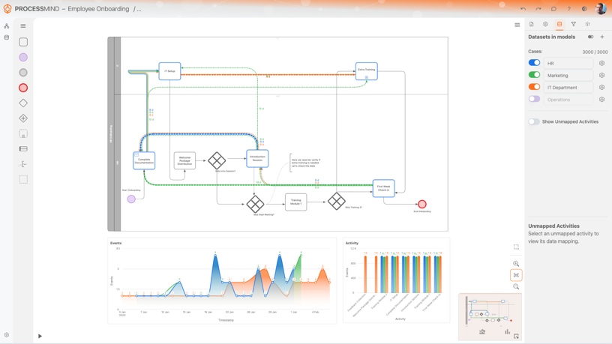
Quick reference guide
Link to Documentation
Modeling object selector
Feedback Form
Dark/Light theme switch
Process Name
Sub-Process
Canvas Menu
Undo
Redo
User Settings menu
Home
Process List
Simulation
Dataset List
Filter settings
Data settings
Object Settings
Notes
Settings Panel
Object selector
Modeling
objects Panel
Zoom In
Fit to View
Zoom Out
Settings Menu
Process Animation
Modeling Canvas Panel
Mini/ Navigation Map

