Slide 1
Uncover the process. Control your progress.
Ver 250317
Unmask hidden inefficiencies, Supercharge productivity, Empower your teams

Slide 2



The Hidden Challenges of Business Operations
Inefficiencies cost companies millions in lost revenue annually
Lack of process visibility slows decision-making
Employees waste hours navigating unclear workflows

Slide 3




A Smarter Way to Optimize Your Business
Automated process discovery with data driven insights
Visualize clear process models and collaborate seamlessly
Simulate process improvements and design the ideal future state.

Slide 4





How it Works
Discover
Optimize
Transform
Map and analyze existing workflows
Identify inefficiencies and improvement opportunities
Implement continuous improvements

Slide 5

Our Approach
Process mapping captures a blueprint of a process, visualizing its steps, decisions, and flow for analysis and improvement.
Process Mapping
MAP
Process mining uses data footprints to uncover the real way processes work, revealing hidden insights for improvement.
Process Mining
MASTER
MINE
Process Simulation
Process simulation tests different scenarios within a model, predicting the impact of changes before making them in real life.

Slide 6


Ditch the blind spots!
Easily get a perspective from your actual processes by layering manual process design with a data-driven process mining approach to visualize your processes in the way they resonate, without losing grip on the real world.
This method will allow you to use process design features like sub-processes, parallelism, complex branching & decision logic while layering in the factual executed processes information.
This unified perspective will help you diagnose inefficiencies, optimize workflows, and transform your operations all within a single solution.
Save time, money, and frustration while empowering your teams to champion change and make processes work for you.
MAP
MASTER
MINE

Slide 7
Traditional product capabilities.
Pro’s & Con’s
Process Design
Process Mining
Process Simulation
Clarity and structure
Familiarity and acceptance
Ease of implementation
Captures all process activities including non-digital activities
Cost-effective
Easy collaboration
Quickly outdated models
Overlooking variations and exceptions
No quantitative insights
Fully manual and subjective model creation
Data-driven process models
Process variations and exceptions insights
Uncover hidden complexities
Track process improvements
Complex process visualizations (Spaghetti)
No contextual information on process activities
Lack of real process characteristics (sub-processes, parallelism, complex branching & decision logic)
Long time to value
Data Experts and training required
Risk-free experimentations
Optimize decision-making by forecasting the business outcome
Enhanced communication and collaboration
Lack on data accuracy and dependencies
Model complexity
Potential of misinterpretations
Missing context

Slide 8

What we offer
Process Design
Process Simulation
Process Mining
Clarity and structure
Familiarity and acceptance
Ease of implementation
Captures all process activities including non-digital activities
Cost-effective
Easy collaboration
Data-driven process models
Process variations and exceptions insights
Uncover hidden complexities
Track process improvements
Risk-free experimentations
Optimize decision-making by forecasting the business outcome
Enhanced communication and collaboration
Quickly outdated models
Overlooking variations and exceptions
No quantitative insights
Fully manual and subjective model creation
Complex process visualizations (Spaghetti)
No contextual information on process activities
Lack of real process characteristics (sub-processes, parallelism, complex branching & decision logic)
Long time to value
Data Experts and training required
Lack on data accuracy and dependencies
Model complexity
Potential of misinterpretations
Missing context

Slide 9






From data to insights
From data to insights
RAW Process Data
Add Domain Knowledge
Process Insights
Domain Knowledge
(Process Map)
AI / LLM / Process
Reference models
Order Pizza
Escalation
Modelling Mining Simulation
Process Pizza
CREDITOR MISSING
Event Data
Process
Process Insight
Final Check
CHECKED & APPROVED
Sub: Payments
Process Event Data
(PM Log Files)
Process Models
(BPMN)
REPEAT PAYMENT
Start Payment
Clarify Deviant Invoice
Accept
Deny
Send Approval
Send Approval

Slide 10

Pricing
Trials, Price Model, Self-service

Slide 11
Price Model
ESSENTIAL
STANDARD
PREMIUM
Step into the world of enhanced efficiency and seamless processes with our Essential tier. Experience the transformative power of our SaaS product, equipped with all the necessary features to kickstart your journey towards operational excellence.
Unlock the full potential of process improvement with our Standard tier. It's designed to empower you with all the functionalities of our SaaS product, enabling you to visualize, optimize, and streamline your workflows with ease and precision.
Take your process improvement initiatives to new heights with our Premium tier. Ideal for larger organizations looking to scale, this tier provides unrestricted access to all product features, fostering collaboration and driving maximum efficiency across your enterprise.
All modeling features
All process mining features
1 GB Storage / User
1 GB Storage / User
Process Simulation
Process Animation
Process Documentation
10 GB Storage / User
Multiple Tenants
Full Audit Logs
White Labeling
$99/Month
$139/Month
$199/Month
Save 15% On Annual Subscriptions
All prices shown are per user exclusive of VAT

Slide 12
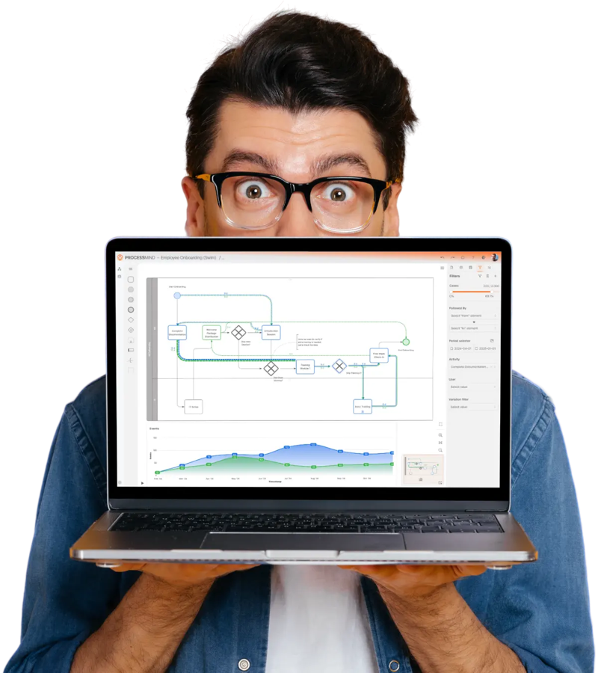

Start your 14-day Trial Today!
Free Trial
No credit card required. No software to install.
What is included
14 days Unlimited access to all features
Full access to our guides/ manuals
Questions? Talk to an expert
https://processmind.com/freetrial

Slide 13






Why ProcessMind
All-in-One Solution
Integrates process mining, design, and simulation for complete process visibility.
Bridge the gap between ideal and real, optimize workflows, and drive efficiency effortlessly.
Flexible & Fast
Tailor analyses to your needs with the fastest ROI and zero deployment.
Effortless Data Handling
Simple, quick data uploads for instant insights.
User-Friendly
Designed for seamless collaboration with a structured, human-centric approach..

Slide 14

Why Partners want to work with us
So why choose us
White label your own environments
Multi-tenant setup for your customers
Users accounts can be shared across tenants
Upscale or downscale your license on demand
Scalable architecture to grow with your business
Dedicated Partner Support

Slide 15










Follow us on the following socials,
or contact us directly.
processmind.com
+31850606809
info@processmind.com

Slide 16
Show Case
Product screen shots
Date 03-01-2025

Slide 17
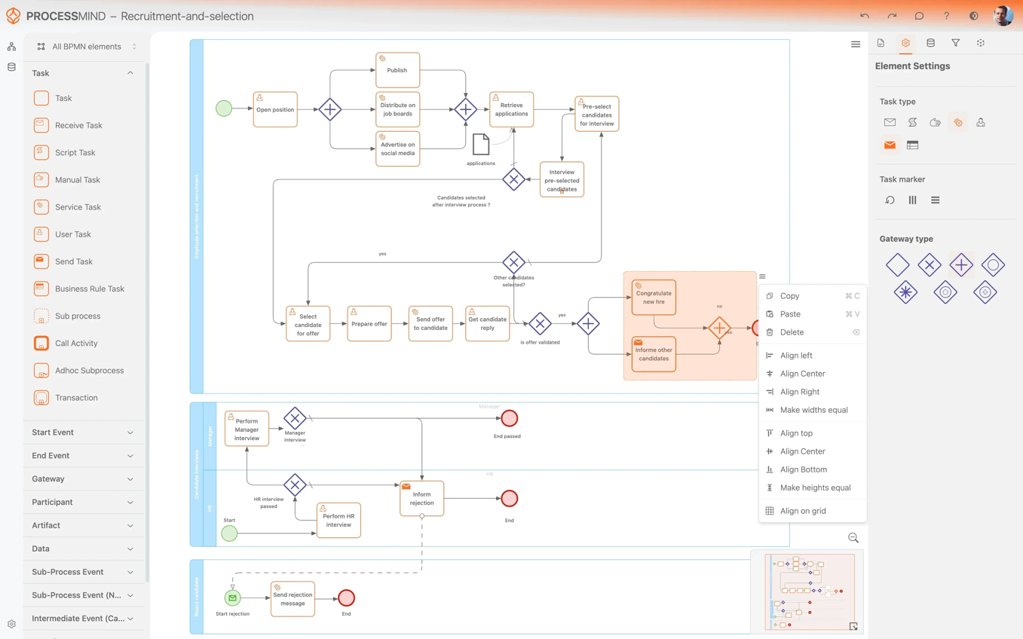
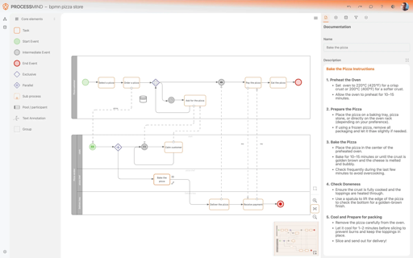
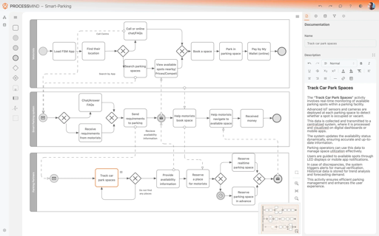
Process Design

Slide 18
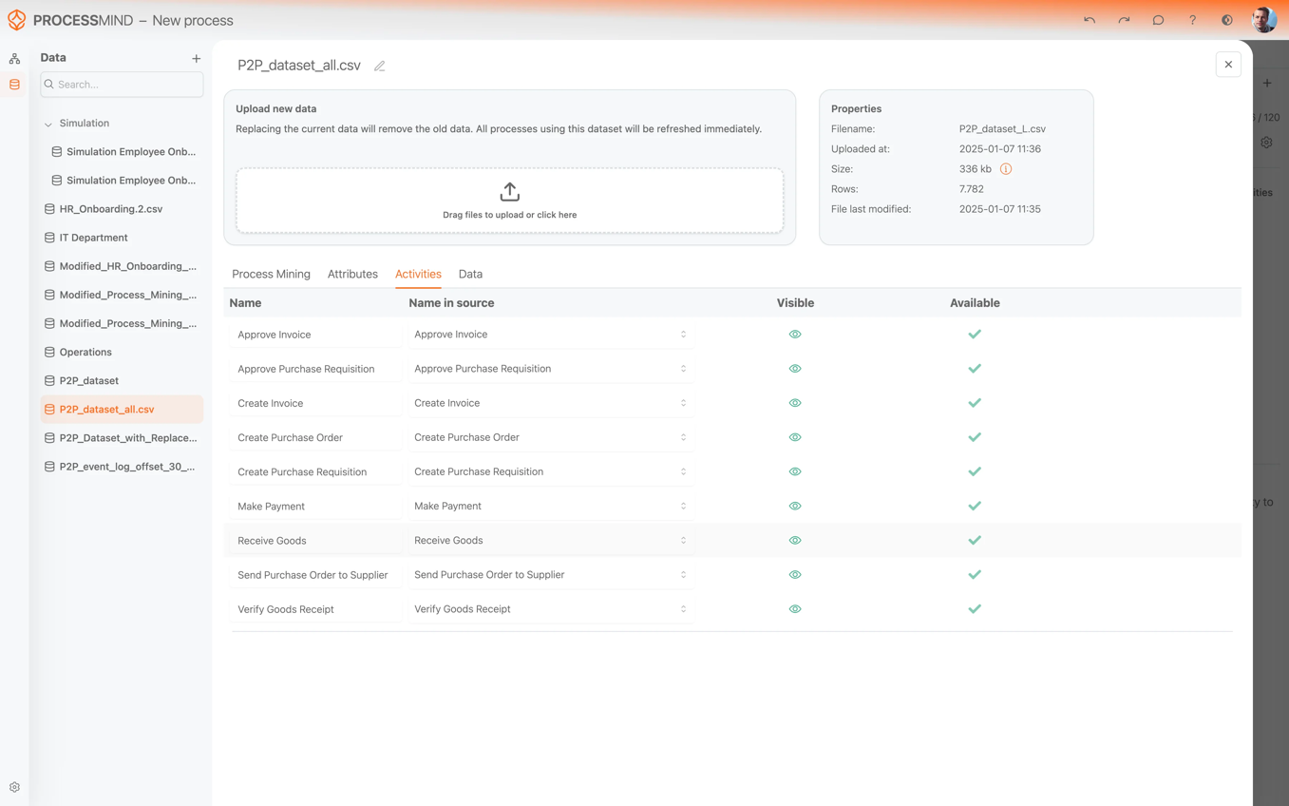
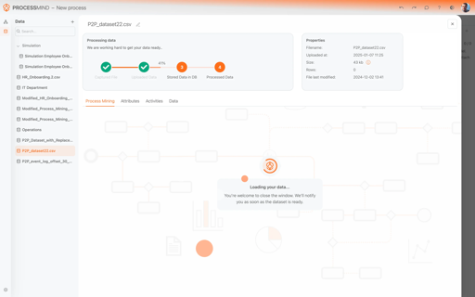
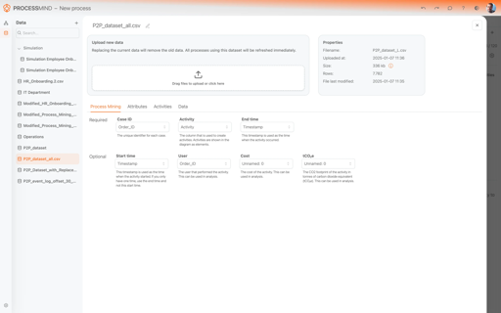
Data Handling

Slide 19
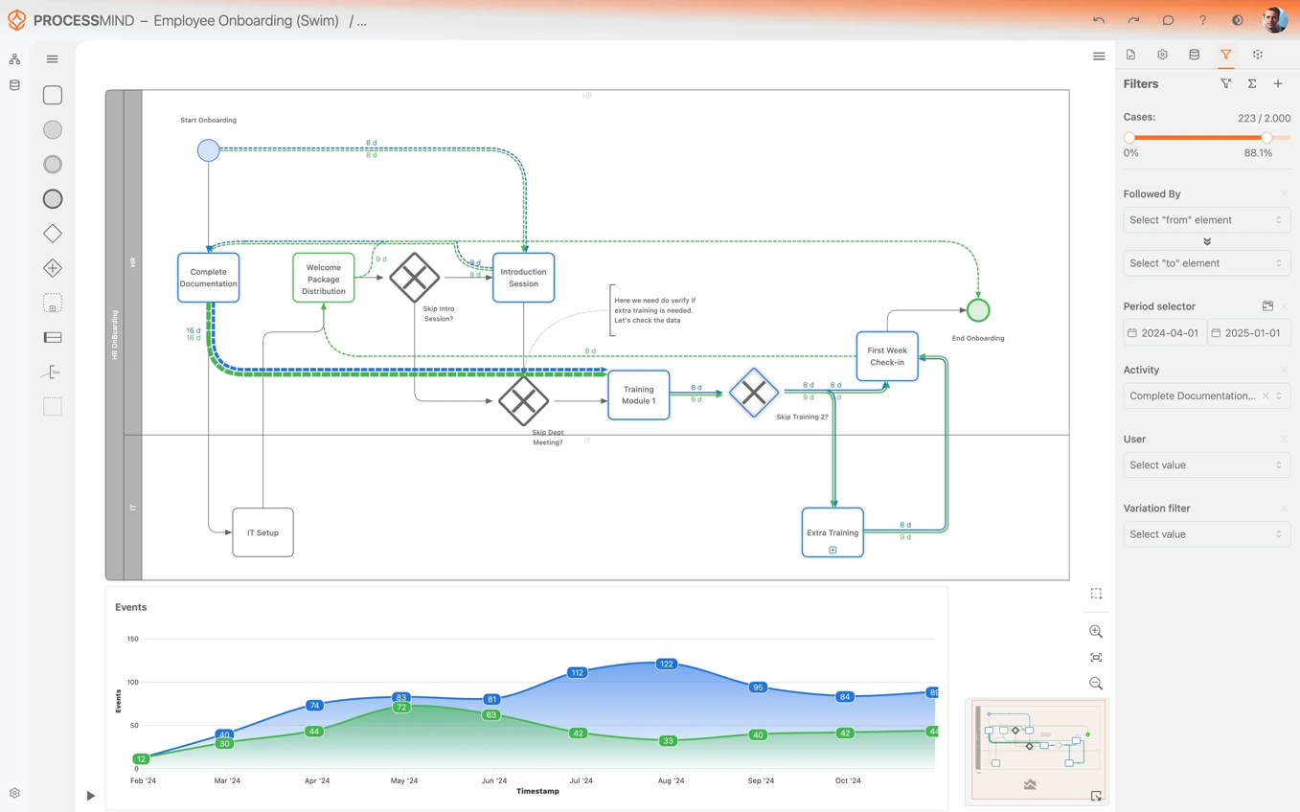
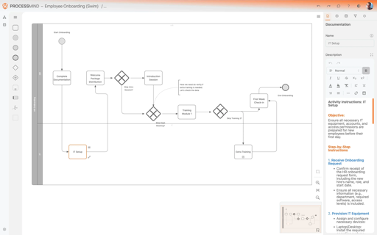
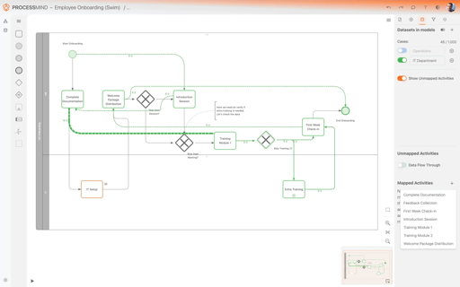
Process Design With Data

Slide 20
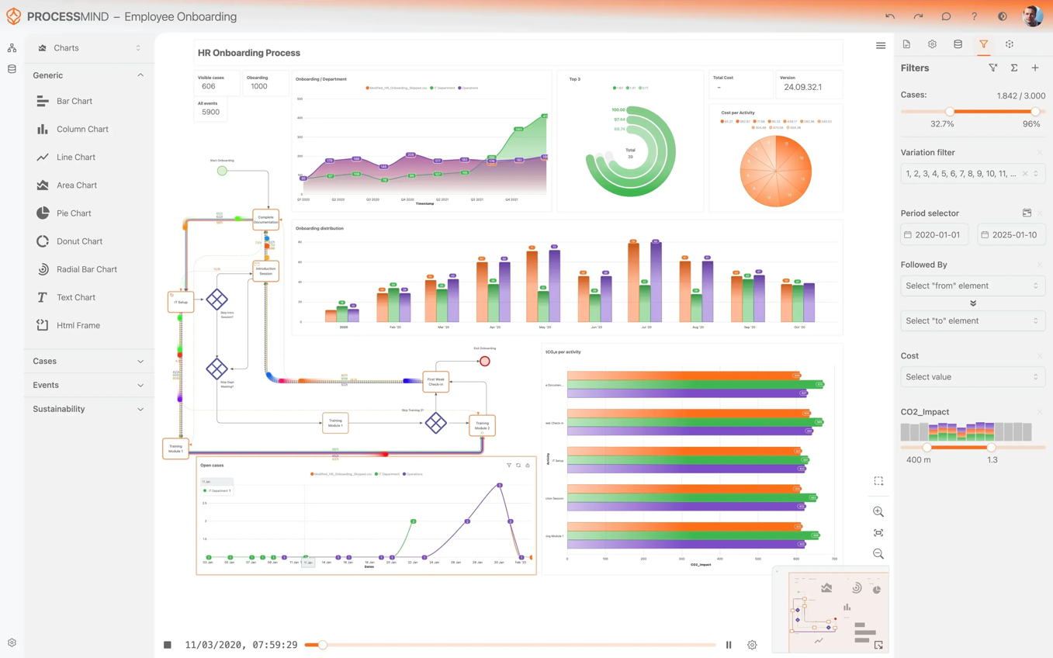
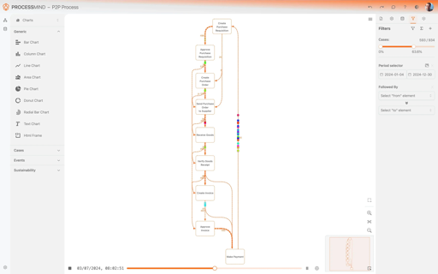
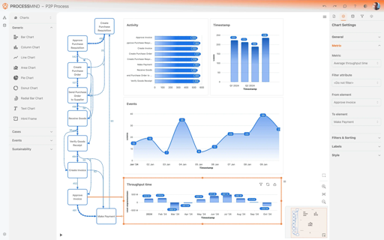
Process Mining

Slide 21
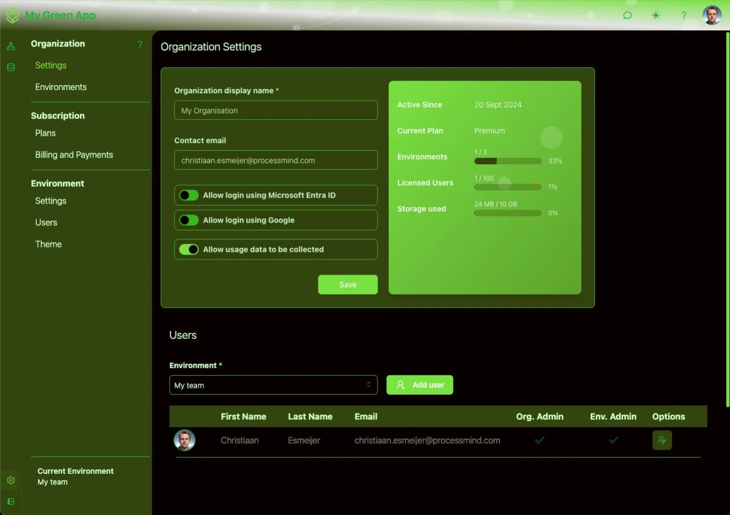
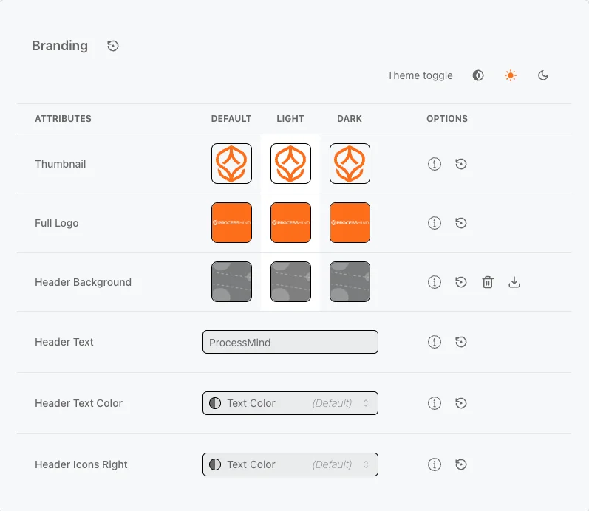
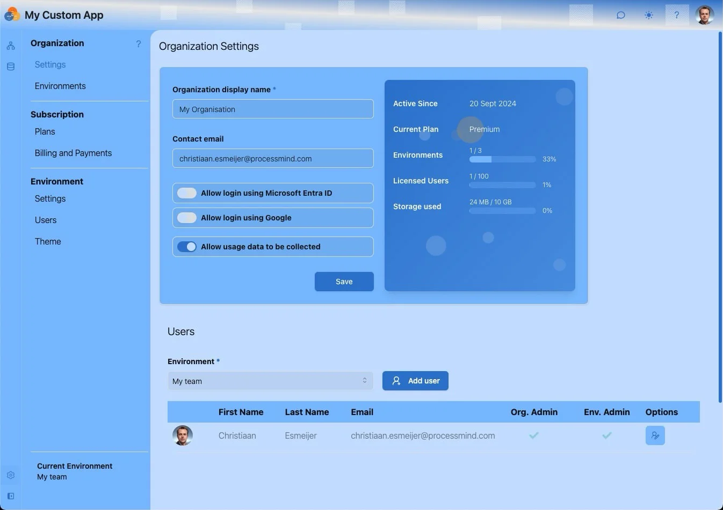
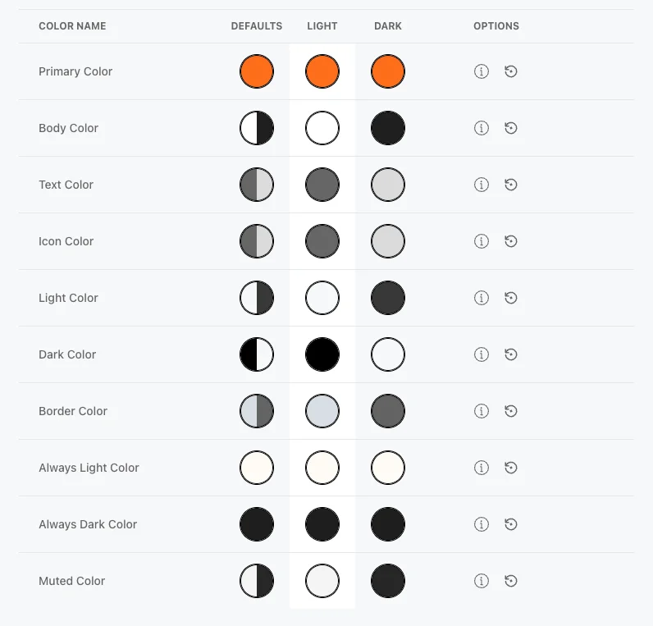
Themes & White Labeling

Slide 22
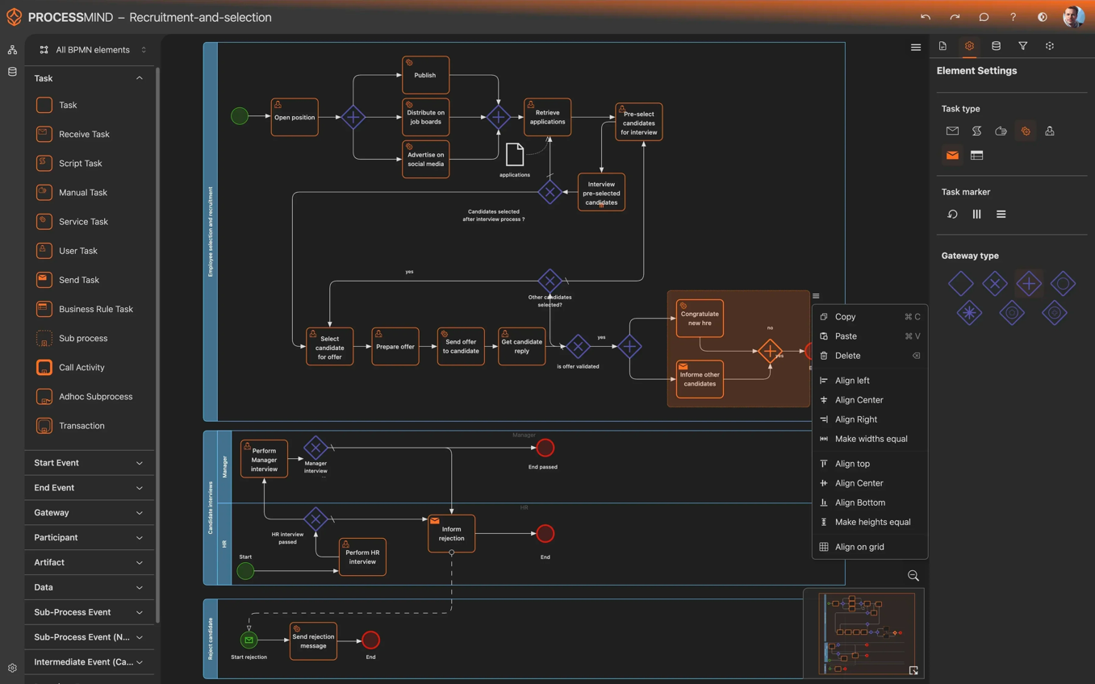
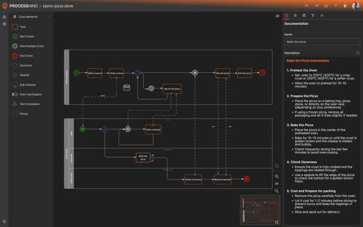
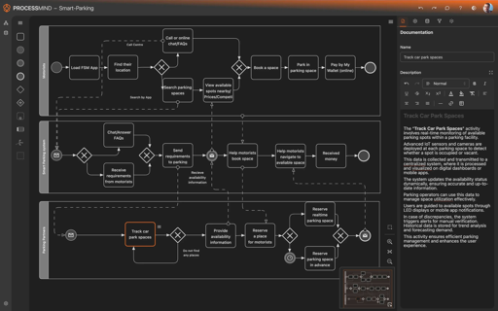
Process Design (dark)

Slide 23
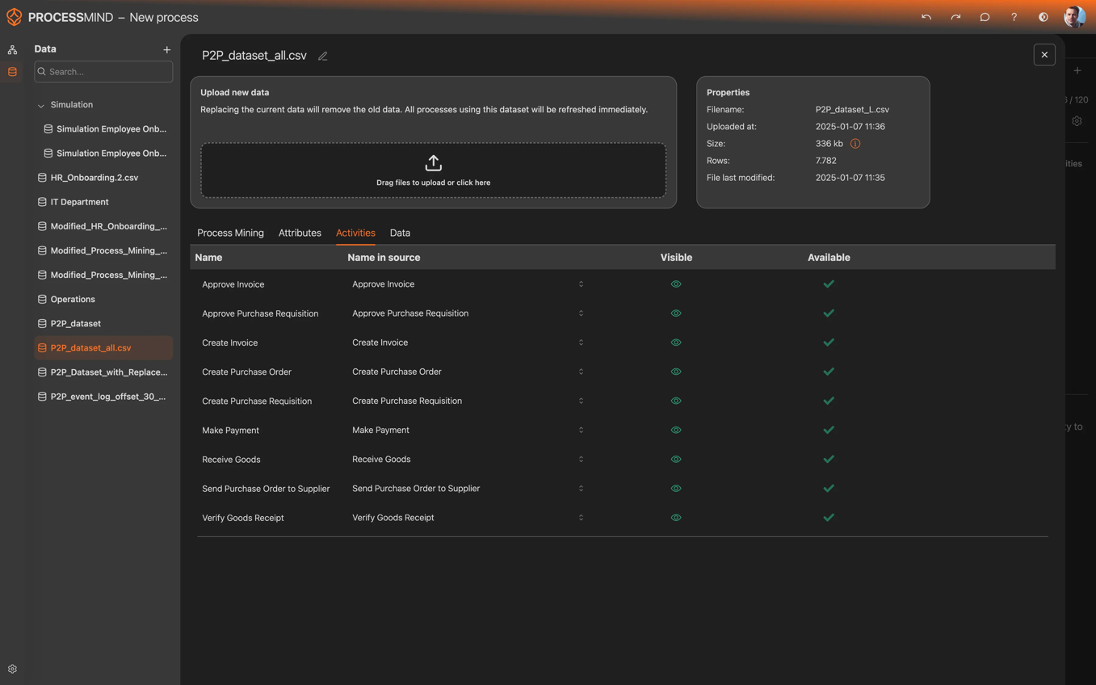
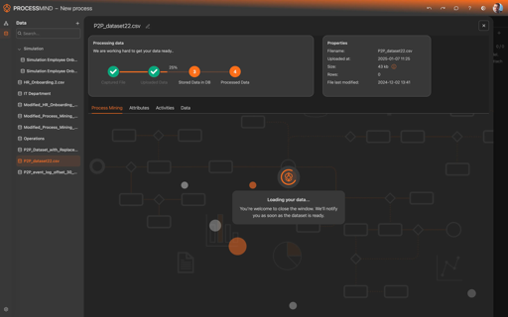
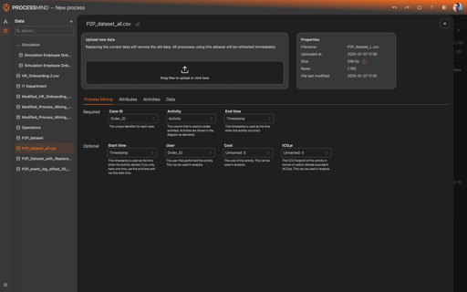
Data Handling– (dark)

Slide 24
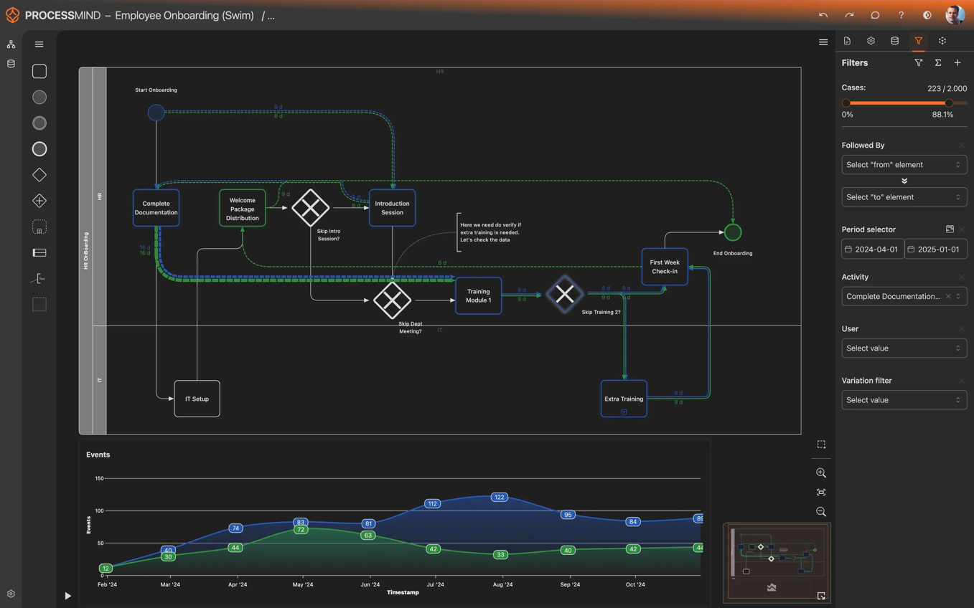
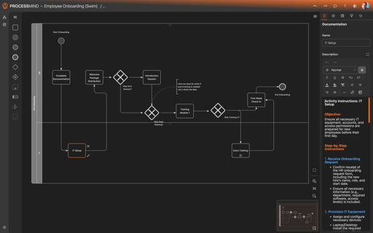
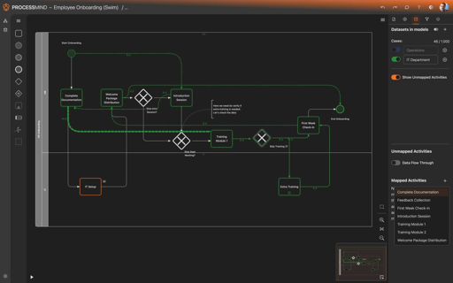
Process Design With Data (dark)

Slide 25
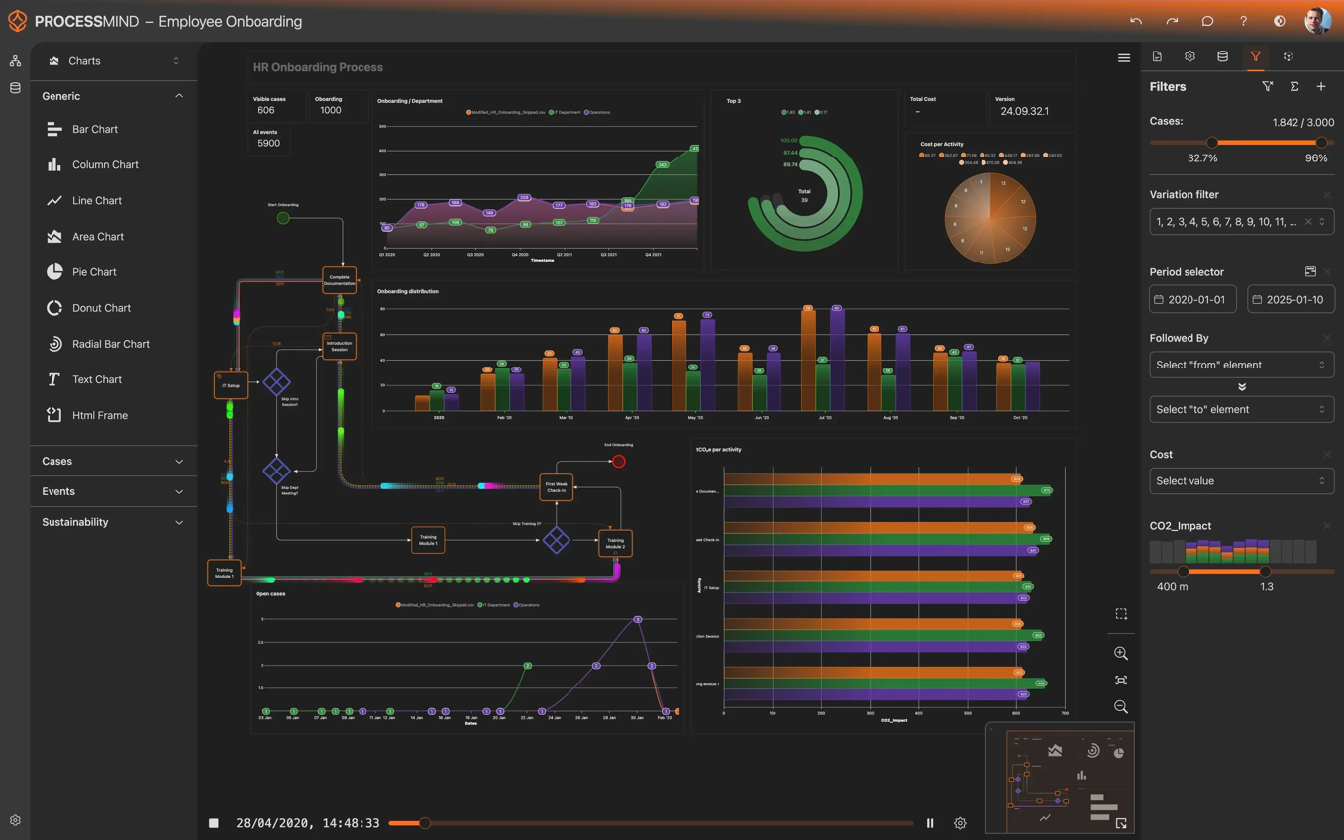
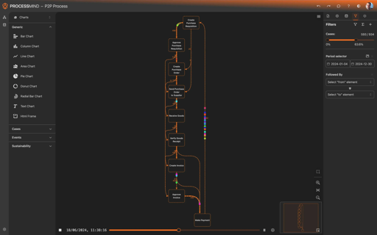
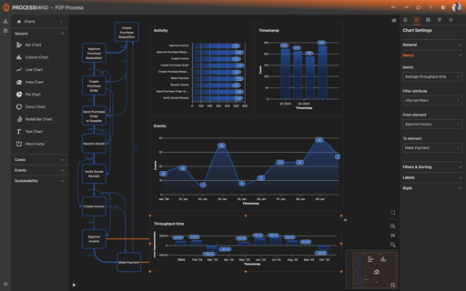
Process Mining – (dark)

Slide 26


Slide 27
Mission & Vision
Our Purpose, Our Path,
Our Promise

Slide 28
VISION
To empower every organization to unlock the full potential of their processes, transforming them from opaque obstacles to transparent drivers of efficiency, innovation, and growth.

Slide 29
Mission
To empower organizations with a truly self-service process intelligence platform that is intuitive, user-friendly, and accessible to all. Our platform delivers actionable insights enabling teams to independently optimize their processes with ease and confidence.

Slide 30
Who we are
The founders of ProcessMind

Slide 31
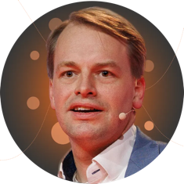
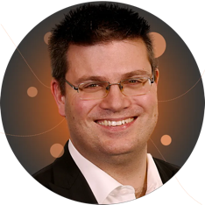




An experienced and passionate team.
Christiaan Esmeijer
Roel Vliegen
Proven capabilities
Co-Founder
Co-Founder
We understand how to build scalable user centric software.
15 years of experience at the intersection of business and technology. Successful serial founder (ProcessGold). Deep passion for applying technology to drive process efficiency.
Serial Founder (ProcessGold, Magnaview) with deep passion for data visualization. He thrives on finding clarity in complexity.
We understand our market well with 15+ years of experience.
We excel at fast execution and adapting quickly to market changes.

Slide 32
Our Core values
Swiftly Delivering Imaginative, Transparent, Helpful, and Enthusiastic Solutions

Slide 33
Core Values
"We infuse our products with fast-paced enthusiasm and transparent clarity, ensuring you receive imaginative and helpful support so you can drive success."
IMAGINATIVE
TRANSPARENT
SUPPORTIVE
ENTHUSIASTIC
MOVE FAST
Creativity Powered by Technology
We are problem solvers who use technology to amplify our imagination and to tackle challenges innovatively.
Build trust with
Transparency
Embedding trust in every layer, we pledge unwavering transparency in our services 'Openness is Our Promise' isn't just a subline, it's our fundamental commitment to you.
Helping You Achieve More
We focus on delivering user-centric software solutions that streamline your workflow and amplify your success with responsive support and empowering tools.
Passionate About Possibilities
Our enthusiasm is the heartbeat of innovation, driving us to passionately explore and create possibilities that empower and inspire our users.
Rapid Innovation, Daring Execution
We are bold about delivering value quickly, choosing incremental progress over perfection.

Slide 34
Core Values
IMAGINATIVE
Embracing "Imaginative" as one of our core values is a testament to our belief in the power of creativity and innovation to solve complex problems and deliver exceptional software solutions.
Being imaginative allows us to envision the future of technology and software services, pushing beyond conventional boundaries to explore new possibilities and innovative approaches.
It fuels our drive to develop unique, user-centric products that not only meet the current needs of our customers but also anticipate future trends and challenges. This creative foresight enables us to stay ahead in a rapidly evolving digital landscape, offering solutions that are not just functional but also visionary, transforming the way our users interact with technology and their environment.
Our commitment to being imaginative is the cornerstone of our mission to deliver pioneering software solutions that empower, inspire, and lead the industry forward.

Slide 35
Core Values
TRANSPARENT
Adopting "Transparent" as one of our core values underscores our dedication to building trust and fostering strong, honest relationships with our customers and stakeholders.
Transparency is vital in today's digital age, where the clarity of operations, data usage, and business practices directly influences customer confidence and loyalty.
By being transparent, we commit to open communication, ensuring that our users are fully informed about how our services work, the value they provide, and our pricing structures without hidden fees or conditions.
This openness extends to our internal culture, promoting accountability and continuous improvement among our teams.
Our transparent approach empowers customers to make informed decisions, reinforces our integrity, and lays a solid foundation for long-term partnerships. It reflects our belief that in the complex world of SaaS, clarity not only drives success but also cultivates an environment of mutual respect and collaboration.

Slide 36
Core Values
HELPFUL
Embracing "Helpful" as one of our core values reflects our unwavering commitment to providing support, guidance, and solutions that truly make a difference in our customers' lives.
This value is rooted in the understanding that our success is directly linked to the success of those we serve. By prioritizing helpfulness, we ensure that our software is not just a tool, but a partner in our users' endeavors—designed to ease challenges, enhance efficiency, and enable growth.
It drives us to go beyond mere transactions to understanding and addressing the unique needs of each customer, offering tailored advice, responsive support, and a continuously improving product suite.
This focus on being helpful fosters a culture of empathy, encourages innovation aimed at solving problems, and builds a strong, supportive community around our services. Ultimately, our dedication to help is about empowering users to achieve their goals with as little friction as possible, making their journey smoother and more productive.

Slide 37
Core Values
ENTHUSIASTIC
Having "Enthusiastic" as one of our core values is fundamental because it embodies the energy and passion we bring to every aspect of our work. This enthusiasm is what fuels our relentless pursuit of excellence, drives us to constantly innovate, and keeps us resilient in the face of challenges.
It's the spark that ignites our creativity, motivates our teams, and inspires us to exceed customer expectations at every turn. Our spirit and devotion are infectious, creating a vibrant work culture and a dynamic customer experience.
By being enthusiastic, we not only commit to delivering top-tier software solutions but also ensure that we do so with a positive, can-do attitude that encourages growth, learning, and continuous improvement.
It's this spirited approach that makes our services not just effective but also delightful, fostering a sense of excitement and possibility that reverberates through our community of users and stakeholders.

Slide 38
Core Values
FAST
Valuing "Fast" as a core principle is crucial in our fast-paced, ever-evolving digital world. It reflects our commitment to efficiency and agility in our service delivery and product development.
Our emphasis on speed ensures that we respond promptly to customer needs, rapidly adapt to market changes, and continuously deliver innovative features and updates that keep our users ahead of the curve. By integrating swift execution into our operations, we help our clients stay competitive by minimizing downtime and maximizing productivity.
Our dedication to being fast also applies to our internal processes, fostering a culture where quick, data-driven decision-making is the norm, enabling us to lead with solutions that are not only timely but also ahead of the trends.
This swift responsiveness is not just about saving time—it's about offering our customers a service that's as instantaneous as the digital world they navigate, providing them with a seamless and efficient experience that's second to none.

Slide 39
Follow us on the following socials,
or contact us directly.
processmind.com
+31850606809
info@processmind.com

